Slide 1
An Interpretable Reasoning Network for Multi-Relation Question Answering
Mantong Zhou, Minlie Huang, Xiaoyan Zhu, et al. An Interpretable Reasoning Network for Multi-Relation Question Answering. International Conference on Computational Linguistics, 2018: 2010-2022

Slide 2
Introduction
Interpretable Reasoning Network: Embedding-based model
KBQA
multi-relation

Slide 3
Task Definition
Input: question and topic entity
Output: an entity in KB as the answer
A path question
one topic entity, one path
A conjunctive question
more than one topic entity, more than one path
Notes:
How old is Obama’s daughter?
Name a soccer player who plays at forward position at the club Borussia Dortmund.

Slide 4
Interpretable Reasoning Network
Input module
Reasoning module
Answer module

Slide 5
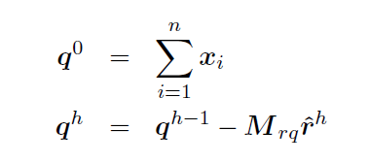
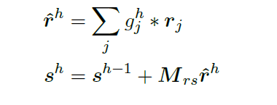
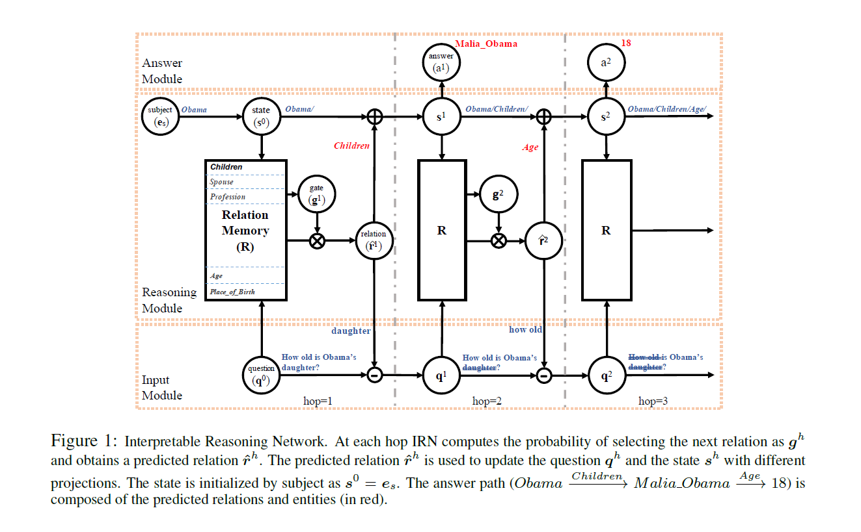
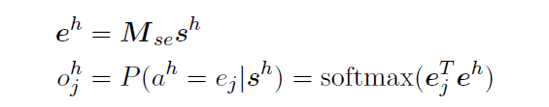

Slide 6
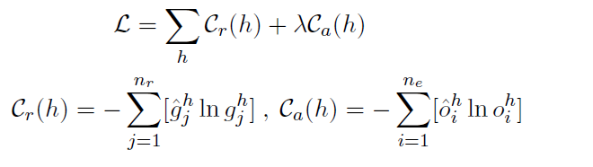
Loss Function
We adopt cross entropy to define the loss function. The first loss term is defined on the intermediate prediction of relations, while the second term on the prediction of entities.

Slide 7

Multitask Training for KB Representation
KB embedding training
QA training

Slide 8
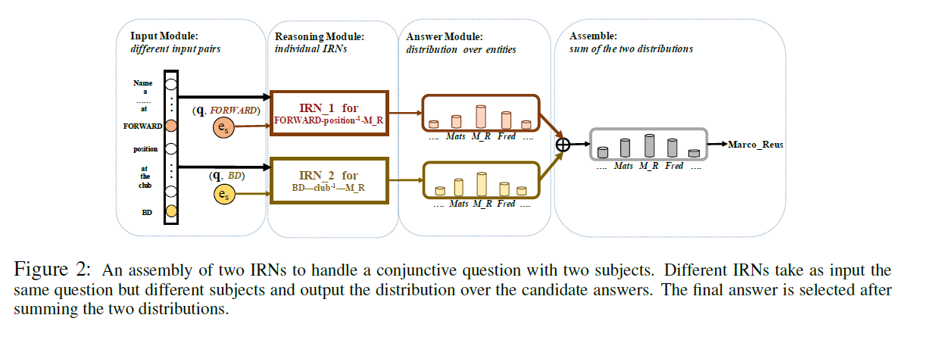
Dealing with Conjunctive Questions

Slide 9
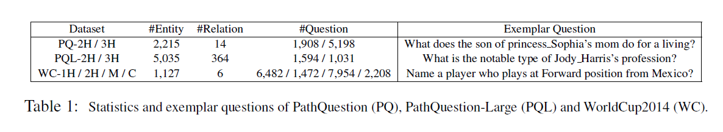
Data

Slide 10
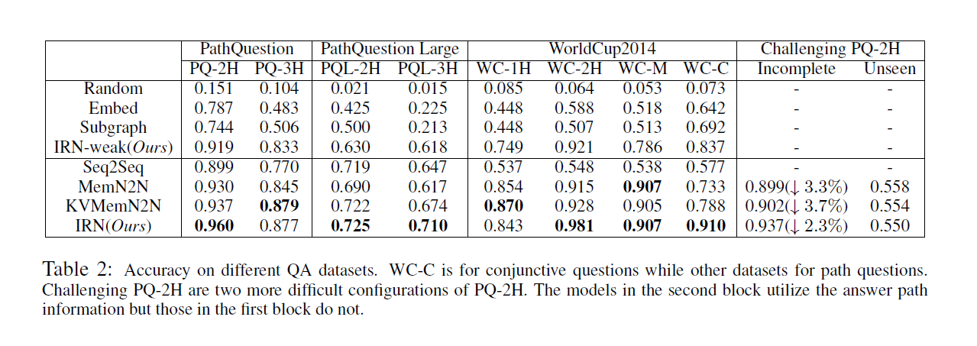
Experiment

Slide 11
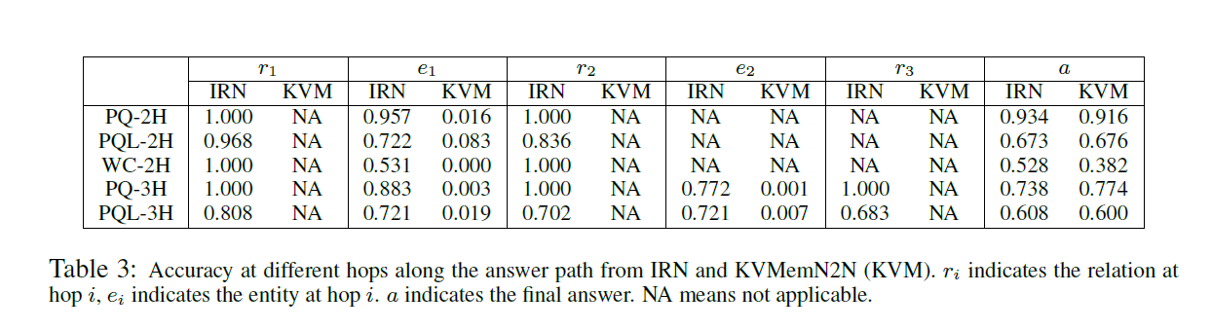
Interpretable Path Reasoning

Slide 12
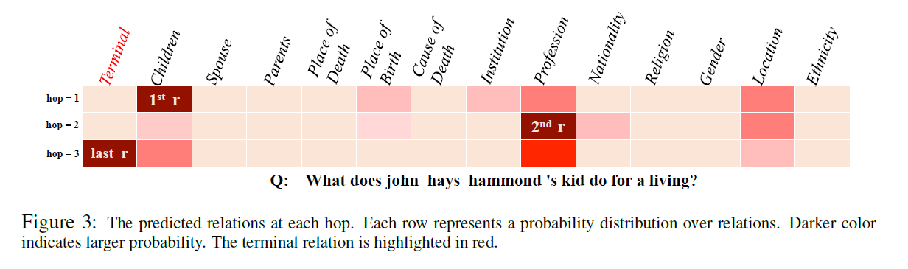
Predicts relations hop-by-hop

Slide 13
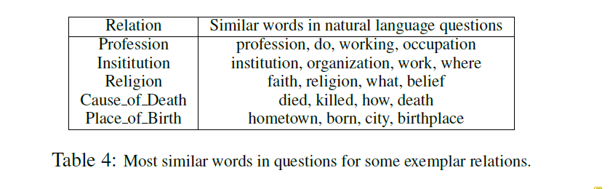
Map relations in KB to words in question

